Slide 1

Archivist
By Scott Selinger, Charles Gilliam, Dung Mai, Robert Edwards, and Tyler Boswell
Stakeholder: Lorraine Richards
Advisor: Rosina Weber
Notes:
Scott

Slide 2

Outline
Project Goal
Demo
Design
Testing
Technical Challenges
Value
Impact
Notes:
Scott
Charles -
Transition:

Slide 3
Project Goal
Notes:
Scott

Slide 4
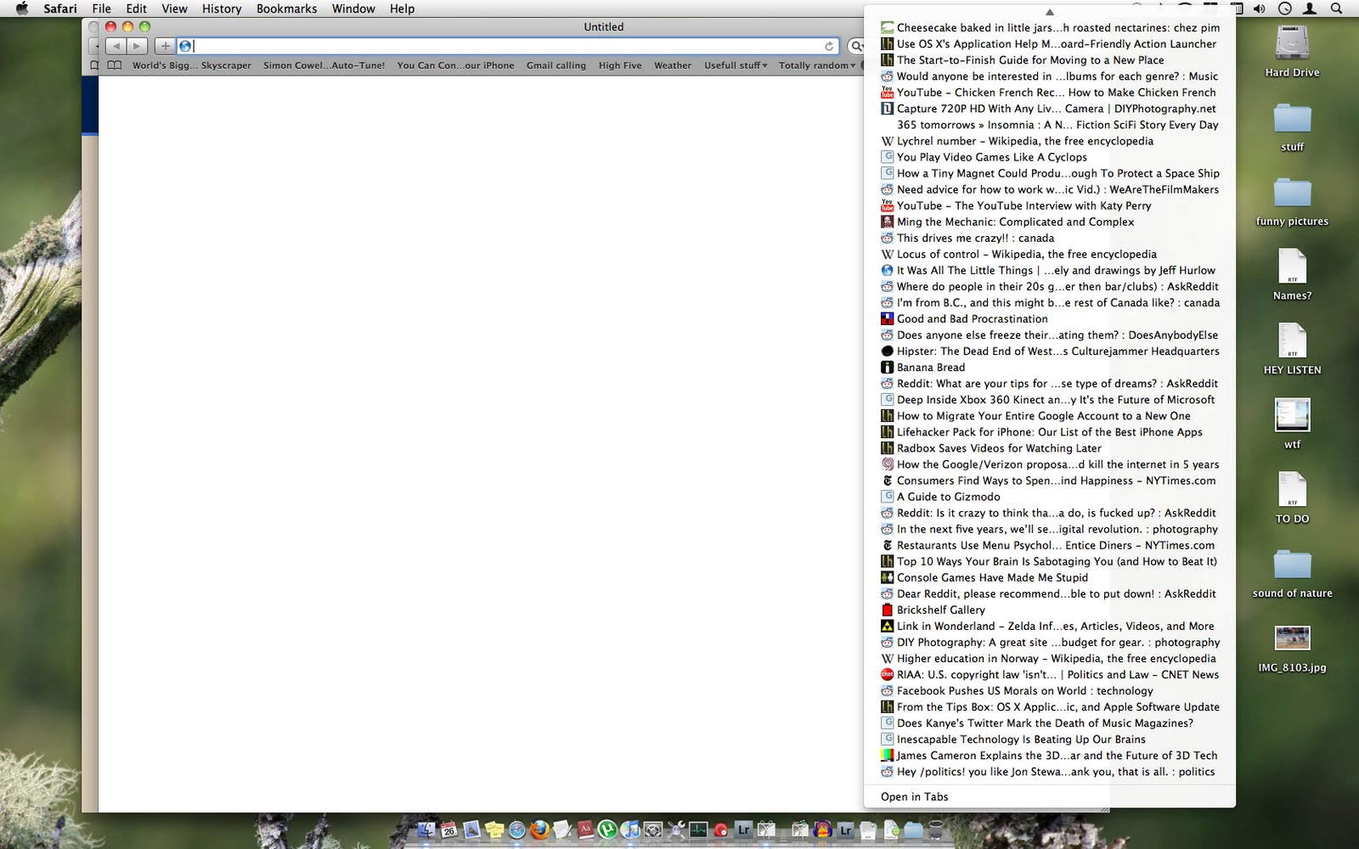
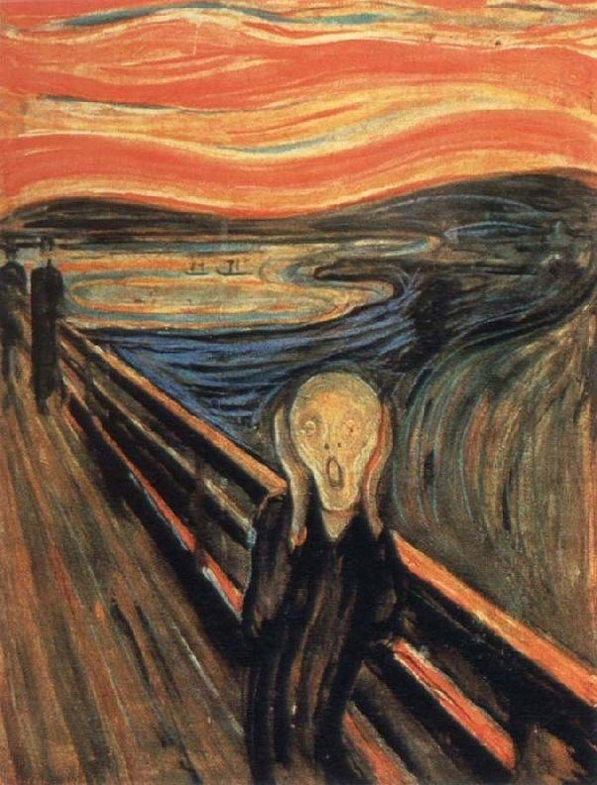
Notes:
Charles
Bookmarks: Internet required, quickly gets out of hand as in the picture

Slide 5
Project Goal
“Allow users to have more meaningful information associated with their webpages and PDFs”
Notes:
Charles

Slide 6
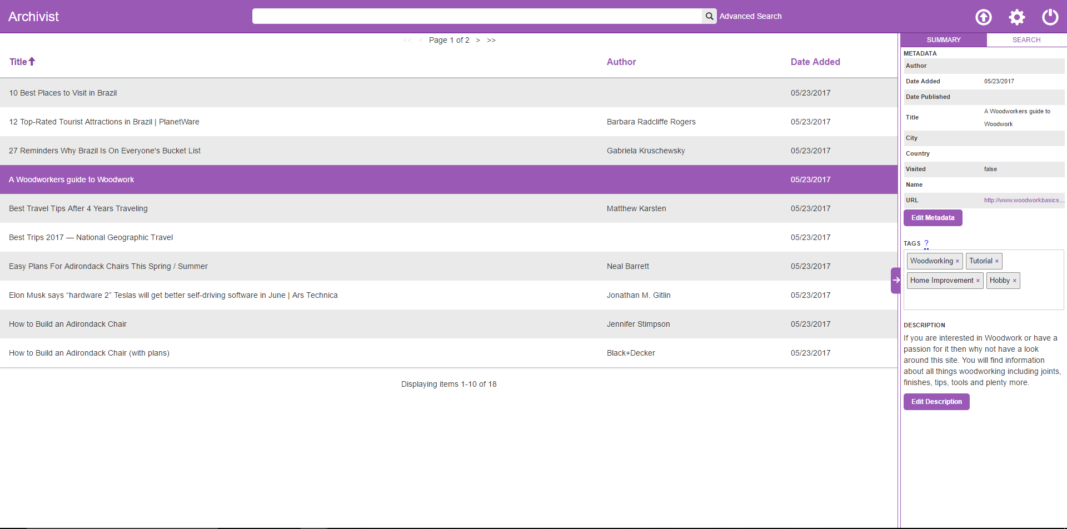
Notes:
Charles
… and then to display it in a nicer way

Slide 7
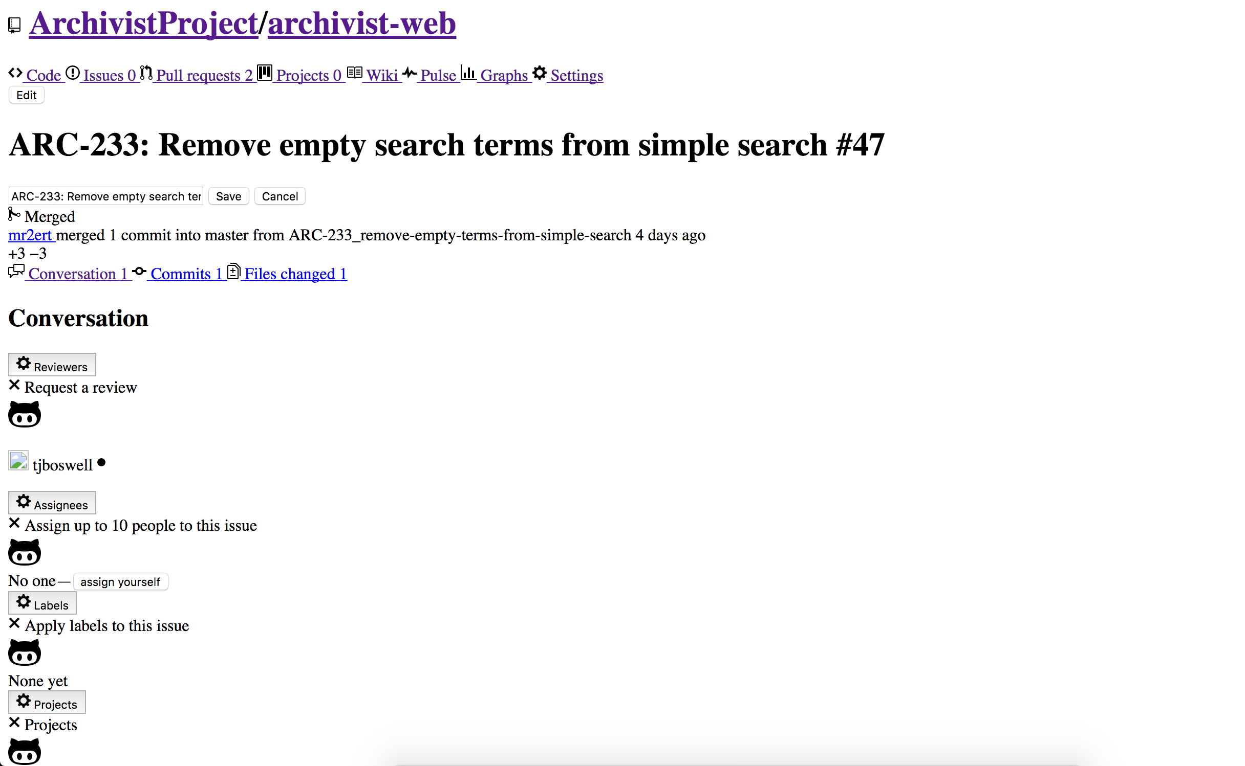
Notes:
Charles
Ctrl+S: Lots of variance between websites, can look passable but frequently looks terrible and is unusable

Slide 8
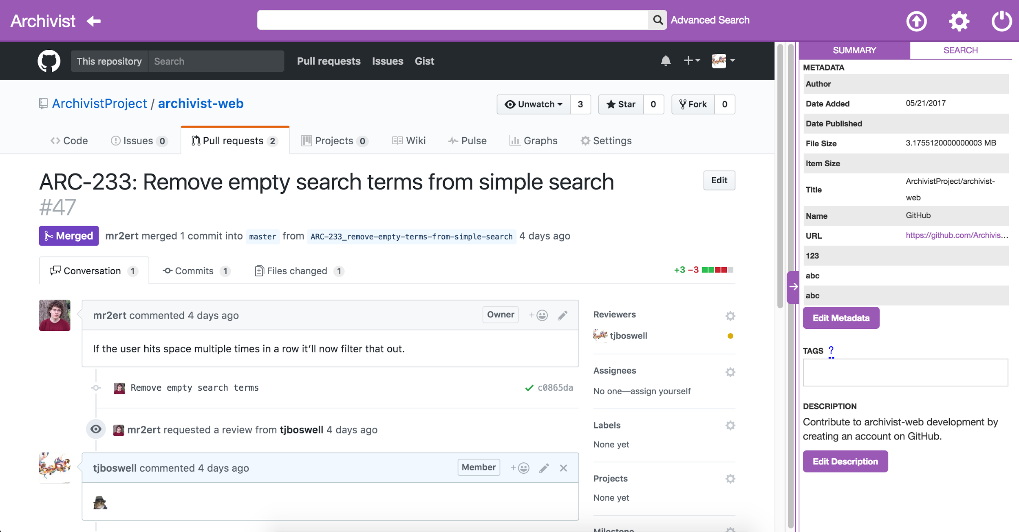
Notes:
Charles
Archivist: Exactly the same appearance as if you were actually on GitHub

Slide 9
Demo
Notes:
Tyler: Drive
Charles: Talk
Say ‘Allow users to have more meaningful information associated with their webpages and PDFs’
You’re planning a trip and have a bunch of past articles saved for ideas
View login screen, main file list, search for travel ideas, look at an article that seems interesting, then search for current articles about that location
Show it saved, show file viewer, and associated metadata/tags

Slide 10
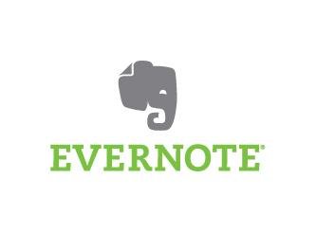




Why is it original?
Self-hosted
Free and open source
Save carbon-copy of a webpage
Focused on archiving
Robust metadata
PDF support
Notes:
Scott

Slide 11
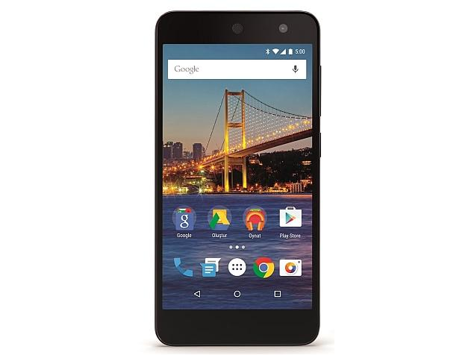




Out of Scope
✔
Notes:
Dung
For our project, there are things that we don’t support for now, such as…..
Mobile application,
The only files that you we support are HTML and PDF,
For HTML files, if there are videos or audio on the page, we do not download or save them
And For operating system, any operating system that can run docker such as windows or mac can run our application.
But again some of these can be supported in the future
Out of scope for this project, not necessarily forever
Not designed for mobile or tablet
Only upload PDF and html files
Audio and video on webpages will not be archived
If it doesn’t support docker, we don’t support it

Slide 12
Design
Notes:
Scott

Slide 13





Design - Management
Relevant Standards and Best Practices
Communication Project Plan Collaboration
Notes:
Scott
Make sure to mention we made a point to use relevant technologies and current best practices
Talk about how we use each of the tools

Slide 14




Design - Development
Relevant Standards and Best Practices
Code Management
Static Analysis
Deployment
Notes:
Rob
To keep up with current best practices we used a whole suite of development tools.
One of the most important ones is GitHub used to manage code in one central repository and to request code reviews
Code Reviews integrated with Travis CI to auto run tests and code quality analysis
ESLint using Air BnB rules for Extension and Frontend Code
RuboCop using custom rules for Backend Ruby code
Finally Docker used to simplify development environment configurations and deployment

Slide 15


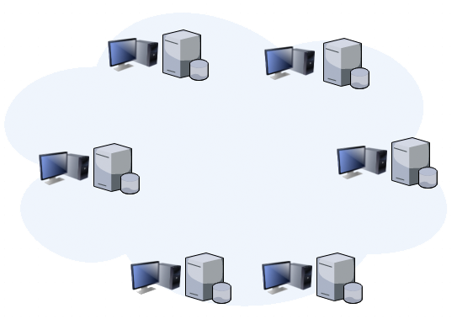
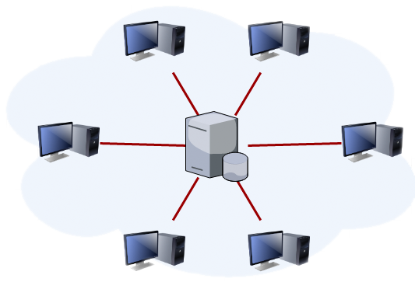
Potential Designs
VS
Pros
Data ownership
Offline access
Hosting Freedom
Cons
Initial setup
Migration
Updating
Pros
Easy setup
Always updated
Cons
Online dependant
Forced updates
Lack of privacy
Notes:
Tyler ~1min

Slide 16
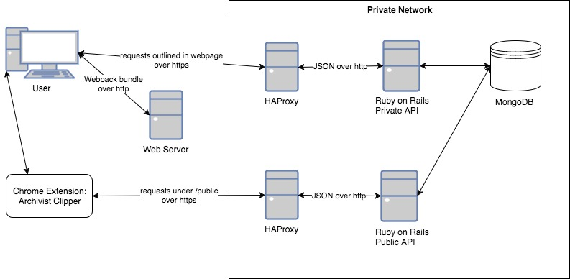



Design - Backend
Relevant Standards and Best Practices
Notes:
Rob
Built with Rails as API layer interfacing with MongoDB which is a nosql DB
Public and Private API, Public only used for extension
Hh proxy between api and user for authentication
Mongo good choice for implementing full text search
But was difficult learning to structure data for mongo custom search queries for efficiency

Slide 17
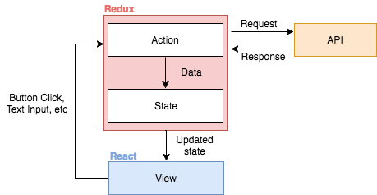
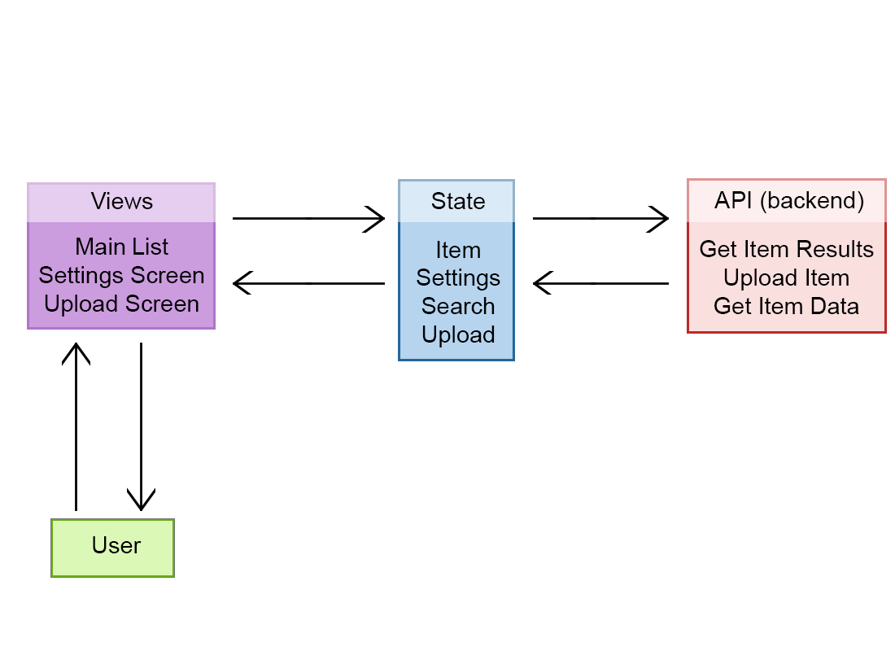


Design - Frontend
Relevant Standards and Best Practices
call action
request
updated state
response
Browser interaction
Notes:
Tyler 30s
Browser event -> creates an action -> calls API if needed -> sends data to state -> view updates based on state
Example: click on document, action calls API to get document content, updates state with content, viewer shows content

Slide 18
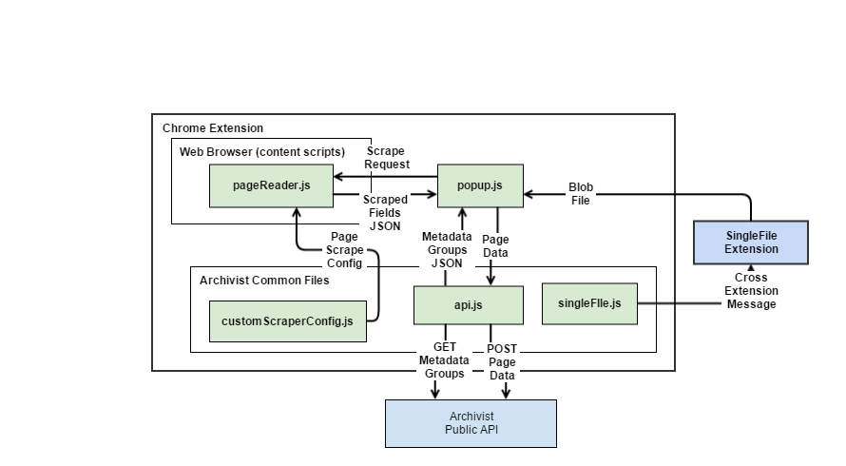

Design - Chrome Extension
Relevant Standards and Best Practices
SingleFile
Core
Notes:
Rob
Now on to how the extension works
First we make request to the Archivist public API to get all the users configured metadata fields
After this we want to determine if there is any relevant information we can automatically scrape, if not we use the Open Graph standard that is also used by facebook
The actual saving of the webpage is done by making a request to another extension SingleFile Core.
SingleFile packages all of the web page’s script and style dependencies into one file while maintaining the look of the page
Finally this file and the users metadata info is sent back to the public API to be saved.

Slide 19
Testing
Notes:
Dung

Slide 20

Testing Plan
Code review
Black box
Unit testing
Formal test cases
Notes:
Dung
-we have several ways that we test our code.
-we do code review and black box testing, whenever a team member finishes a new feature, other team members will look at his code to see if there’s any problems and they also perform black box testing by actually using the application. If everything is good then we add that new feature in.
-we also have unit testing for the backend
-and formal test cases for each different feature, we made sure we have all test cases for all features

Slide 21
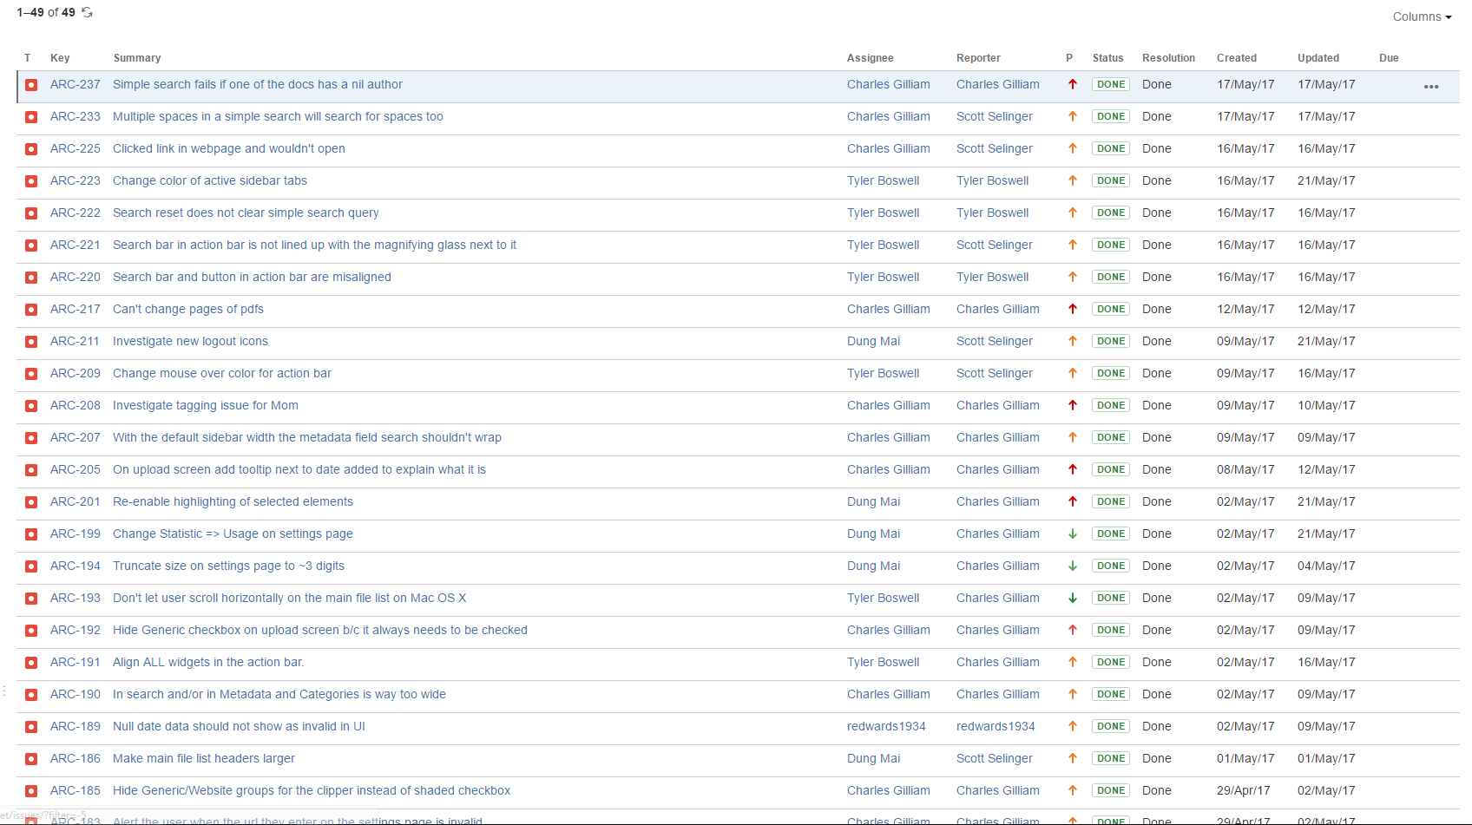
Notes:
Dung
So we document all the bugs that were fixed in JIRA.

Slide 22
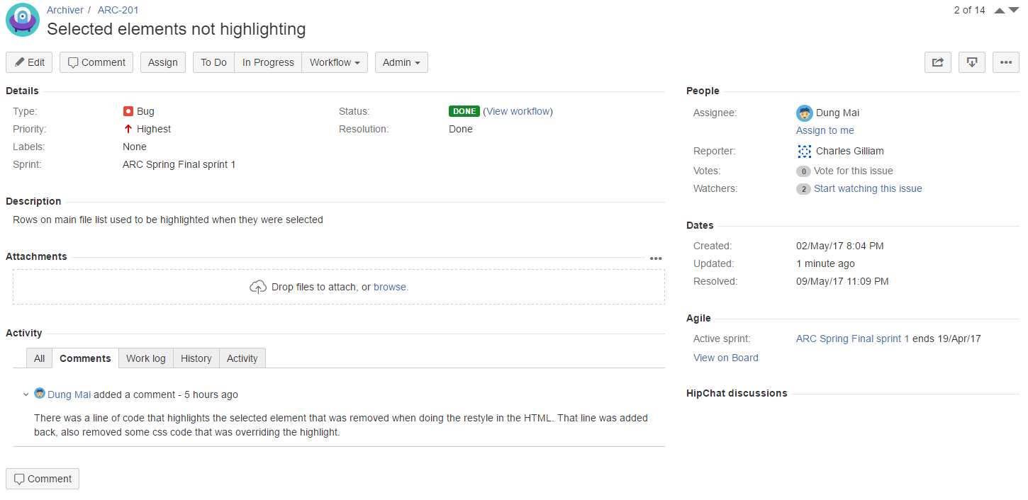
Notes:
Dung
So we document the bug by saying what is the bug and how to replicate that bug along with when this bug was found. Then whoever fixes the bug would document how they fixed it and when did they fix it. IN the future, if tehres any problem, you can go back and see if the problem was caused by a bug that was fixed.

Slide 23
Technical
Challenges
Notes:
Charles

Slide 24
Technical Challenges
HTML PDF
Notes:
Charles
Use term non-binary if we wanna compare to brain group
What about using the term unbound in regards to the data we have to deal with?

Slide 25
Technical Challenges
HTML PDF
???
???
Notes:
Charles

Slide 26

Technical Challenges
Designing models & optimizing search algorithm
Ensuring that the saved web pages don’t do anything (accidentally) malicious
Lots of interactive UI widgets
Notes:
Charles
Tyler
Rob
Dung
Security — strip out javascripts but this doesn’t interfere with the webpage being saved because singlefile saves the page after the javascripts load (and use it as the base)

Slide 27
Value
Notes:
Scott

Slide 28
Value - Statement
“Product will be a success if 70% of users find it easier to use and improves on their current experience and processes”
Notes:
Scott

Slide 29
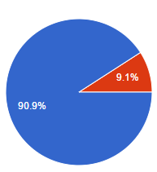
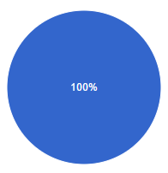

Value - Results
11 Responses
“Would you want to keep using Archivist?”
“Do you think Archivist would enhance your current process of managing and organizing webpages and PDFs?”
Notes:
Scott
Statement on left was our original value statement, and on the right was our end results of the user survey
Do you think Archivist would enhance your current process of managing and organizing webpages and PDFs?
Product will be a success if 70% of users find it improves on their current experience and processes via a user survey

Slide 30
Impact
Notes:
Scott

Slide 31

Notes:
Tyler 15s
Learning new skills

Slide 32
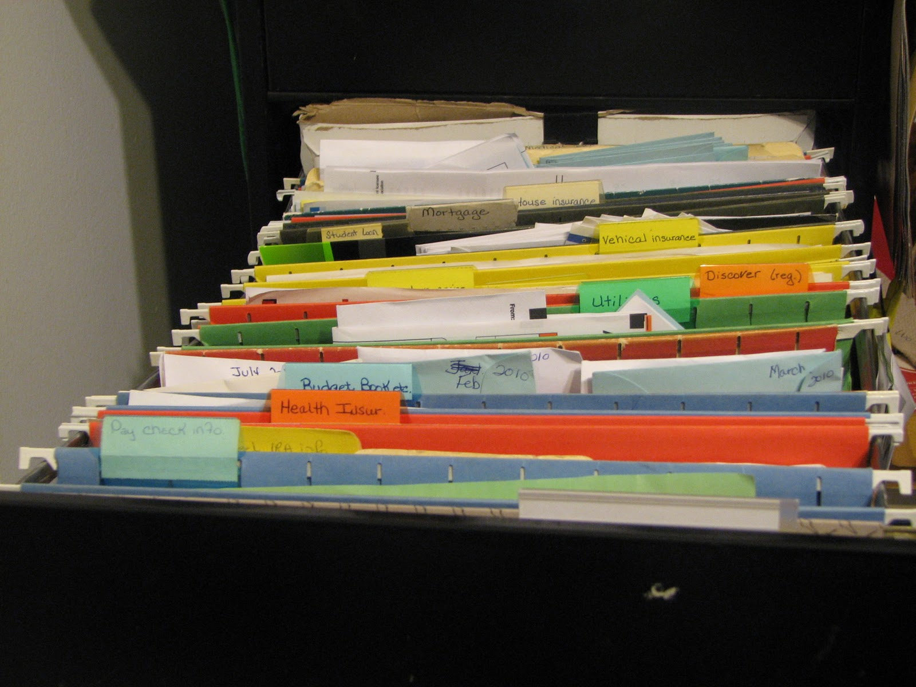
Notes:
Tyler 15s
Personal Records

Slide 33

Notes:
Tyler

