Slide 1

Members:
Tom Amon
Aaron Campbell
Daniel Fitzick
Shishir Kharel
Hoa Vu
Nanxi Zhang
Stakeholder:
Marcello Balduccini

Slide 2
Drexel chatbot
Introduction & Features
Overview of Algorithm
System Architecture & Design
Management
Demo
Limitations & Technical Challenges

Slide 3
Introduction & Features

Slide 4
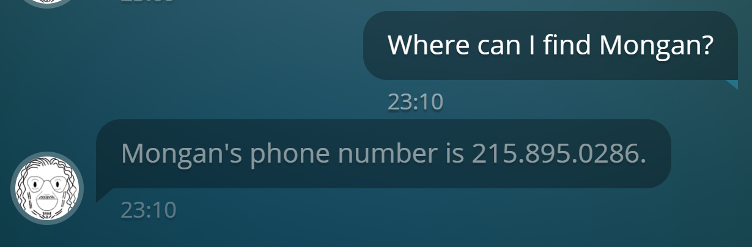
What is drexel chatbot
Question answering system for Drexel
RESTful API
Demo applications (Web, Mobile and SMS)
Notes:
RESTful API – interact with api through http get requests
In addition to the API, we created 3 demo apps to show you how the API functions

Slide 5
Why drexel chatbot
Compared to Google:
More efficient
More user friendly
Gets results faster
Compared to Google Assistant/Siri:
Optimized for Drexel
More information about Drexel
Notes:
Example 1: when you google “what is professor vokoloz’s phone number” it gives website but
Example 2: Google knows when Benedict Cumberbatch was born but won’t be able to answer what is Professor Mongan’s email; faster
Siri and Google are broad; we specialize in Drexel only topics

Slide 6
Why drexel chatbot
Why API
Expandable to other applications
Friendly to other developers
Research project
Focus on the process

Slide 7
features
Input and output in natural language
API
Input by URL parameters
Output formatted in JSON
Concurrent users
Demo applications
Simple interfaces
Enter and send questions; get responses

Slide 8
Supported questions
Faculty
Email
Website
Title
Office
Phone number
Picture
Department
Education
Publications
Research interests
Buildings
Address
Schedule
Picture
Website

Slide 9
Overview of algorithm

Slide 10
inspiration
Google’s “A neural conversational model” (2015)
I am seeing an error related to VPN
What is the error message that you are getting when connecting to VPN using NetworkConnect ?
Connection refused
May I know the version of NetworkConnect you are using?
Wheres Marcello Balduccini office?
Marcello Balduccini office is Rush 233C.

Slide 11
Where is (Faculty)’s office?
(Faculty)’s office is in (Room). [query]
Vokolos’ office is in University Crossings 131.
Where is Vokolos’ office?
Generalize
Populate
Classify

Slide 12
Where is (faculty)’s office?
(faculty)’s office is in (room). [query]
Vokolos’ office is in University Crossings 131.
Where is Vokolos’ office?
Populate
Classify
Generalize

Slide 13
Where is (faculty)’s office?
(faculty)’s office is in (room). [query]
Vokolos’ office is in University Crossings 131.
Where is Vokolos’ office?
Generalize
Populate
Classify

Slide 14
Where is (faculty)’s office?
(faculty)’s office is in (room). [query]
Vokolos’ office is in University Crossings 131.
Where is Vokolos’ office?
Generalize
Populate
Classify

Slide 15
Algorithm design rationale
Less training data
Modular
Adaptable

Slide 16
System architecture & design

Slide 17
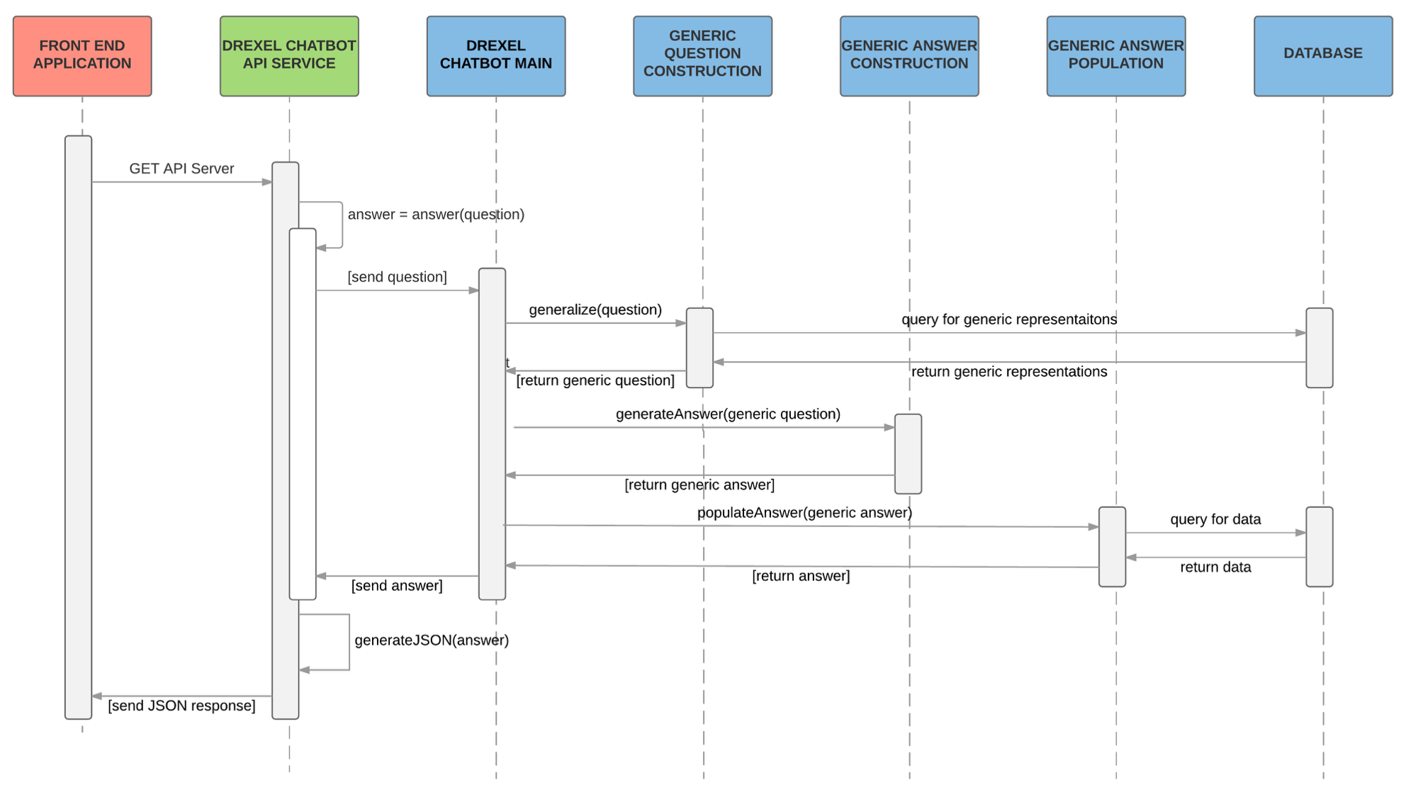

Slide 18



Main languages
Frontend
Java
Java Script
HTML & CSS
API: Java
Backend: Python

Slide 19

API
Basic Model-View-Controller
Calls backend on each GET request
Each requests gets separate process

Slide 20

Generic question construction
“Generalize” step
Natural Language Processing
Identify keywords
Part of speech tagging
Database lookup
Replace keywords with generic form
Notes:
Maybe talk about the the faculty room example here

Slide 21


Generic answer construction
“Classify” step
Neural network
Notes:
Maybe talk about the the faculty room example here

Slide 22
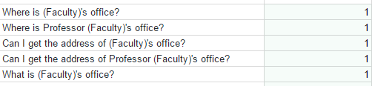
Generic answer construction
18 answer categories
~200 training questions
~7000 training question after adding noise (misspelling)
Notes:
Maybe talk about the the faculty room example here

Slide 23
Generic answer population
Simplest component
Query the database
Replace generic form

Slide 24

database
RDF Database
No tables or keys
Extensibility
One-to-many

Slide 25
Information extraction
Populates the database
20 scripts
Creates TTL(turtle) files
<#Denise-Agosto>
cb:name "Denise Agosto" ;
cb:room "Rush 214B" ;
cb:email "dea22@drexel.edu" ;

Slide 26
Error handler
Allows failing more gracefully
2 types of errors
“I don’t understand the question”
“Sorry I don't have an answer for that. But I found this website: http:...”

Slide 27
Management

Slide 28


Communication

Slide 29
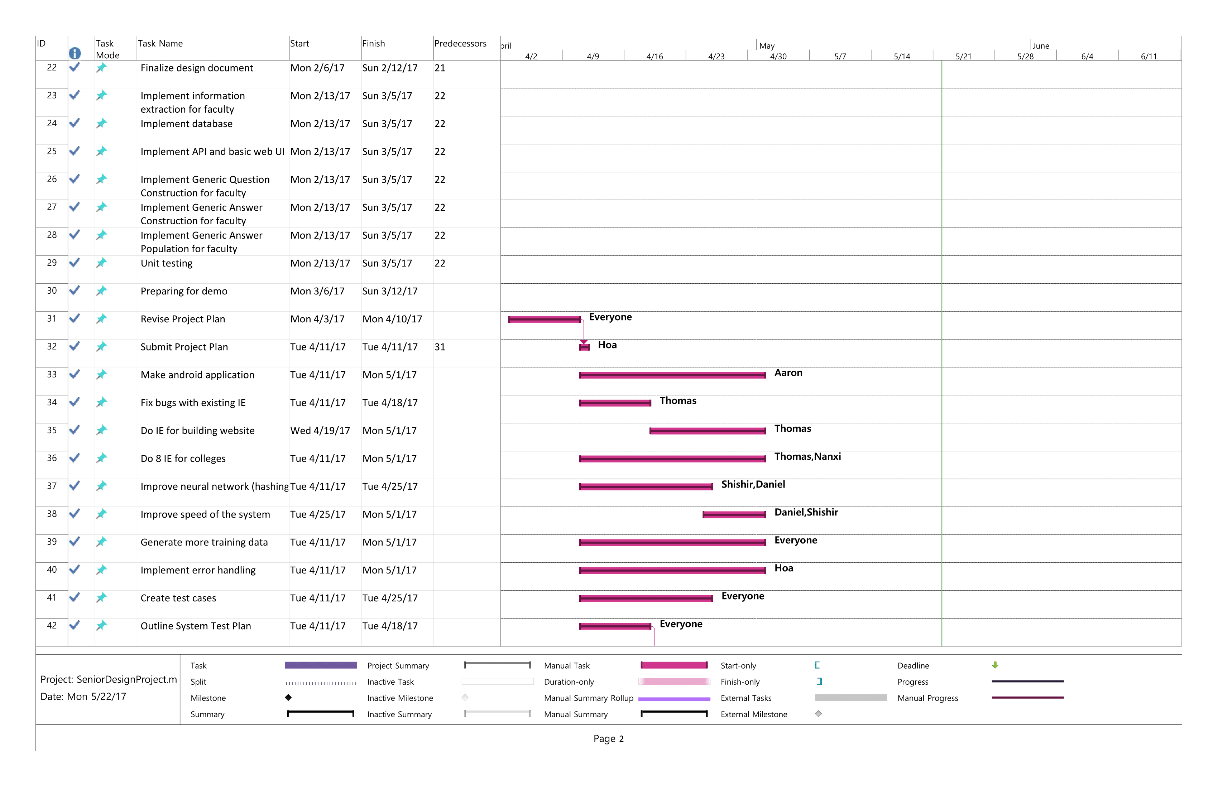

Planning

Slide 30

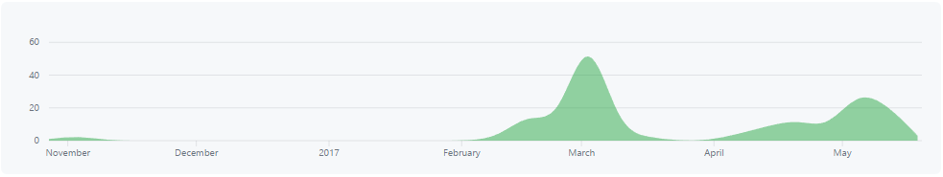
Repository & bug tracking

Slide 31
testing
Unit testing
System testing
User testing
Notes:
J unit & python unit tests

Slide 32
Demo

Slide 33
Limitations & technical challenges

Slide 34
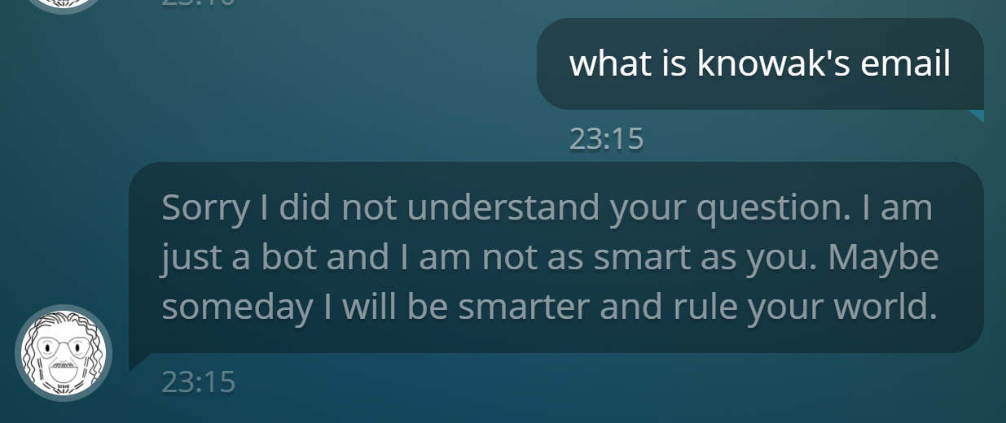
limitations
Input question
No compound
Context-unaware
Keyword-dependent
NLTK
Misidentification

Slide 35
Technical challenges
Database speed
Neural network speed
Lack of data
Notes:
Speed is a priority

Slide 36
conclusion

Slide 37
Questions

Slide 38

Thank you
Aaron, Daniel, Hoa, Nanxi, Shishir, Tom, and Bun

