Slide 1
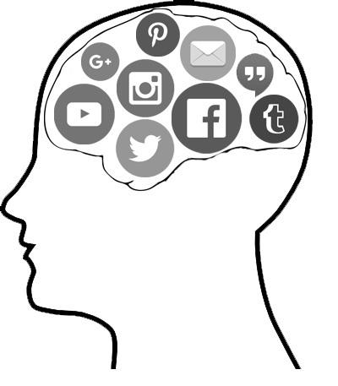
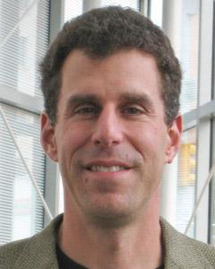
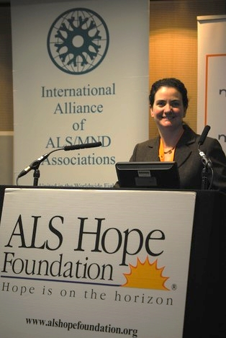
Connectome
Advisor
Stakeholder
Connecting Minds
Khaled Alhendi, Nate Bender, Kevin Garrone, Sheik Hassan, Kennan Meyer, Jon Schuck, Bairavi Venkatesh
Jeff Salvage
Sara Feldman
Notes:
SH
Hello everyone, we’d like to share our senior project with you this evening.
We would like to begin by thanking our advisor jeff salvage, our stakeholders, and also sara feldman of the ALS hope foundation.
The foundation is committed to providing care for ALS patients and also supporting research to cure the disease.
So, what is Connectome about?

Slide 2

Imagine not being able to tell your family that you love them...
Notes:
SH
Imagine for a moment, that you were unable to tell your loved ones that you love them. Imagine not being able to visit them, and being confined to a hospital bed for long periods of time. Imagine not being able to move any part of your body. This is what ALS does to you a disease that can take away all of your movement ability.
Our project aims to provide a social media platform for ALS patients to bring a measure of joy into their lives.

Slide 3
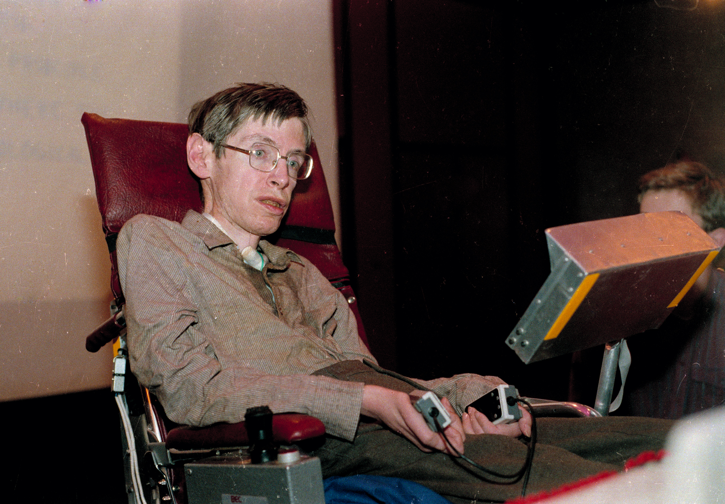
Targeted Users
ALS patients
Patients with limited mobility
Initial symptoms include loss/impairment of:
-Speech -Swallowing -Movement of arms -Extremities
Patients have an ever declining quality of life
Notes:
The initial symptoms of ALS can be quite varied
one person may experience trouble holding a pen or a cup
another may experience changes in their vocal pitch when speaking.
The symptoms are gradual, this is because ALS is a disease with a gradual onset.
Symptoms can begin in the muscles controlling speech or swallowing, or in the hands, arms, legs, and feet.
Not everyone experiences the same symptoms or the same
progression of symptoms.
But everyone experiences the gradual weakening and paralysis of muscles.

Slide 4
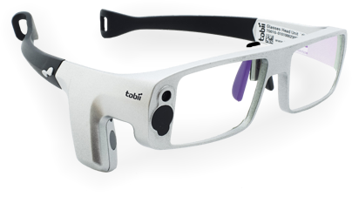
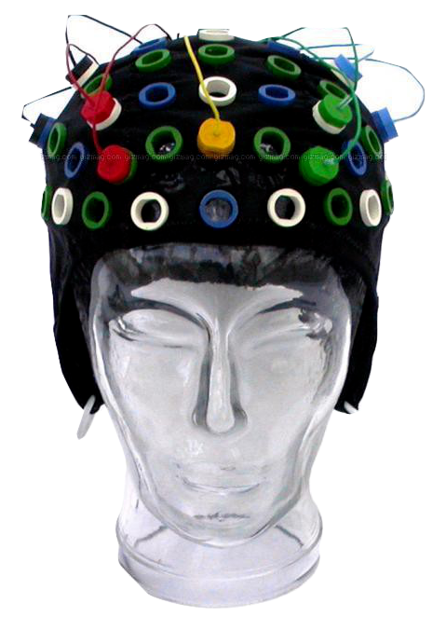
Existing Solutions
Assistive technologies:
Eye Tracking
Sip and Puff System
Brain Computer Interface (BCI)
Research grade BCIs are:
Expensive ($20,000+)
Time consuming to set up
Is there a cost-effective BCI option for recreational applications?
Notes:
SH
Now, there are a few popular assistive solutions:
Eye Tracking,
Which are systems tracking the position of a user's pupils and using the gaze information as input
Then there are Blinking systems that take blinking as input
Then there are Sip and Puff Systems, which take the flow of air when sipping or puffing into a straw as input
And finally BCI’s.
Current BCI options, like you can see on the right, are research grade, containing anywhere from 16 to 256 electrodes and are highly accurate.
But they are extremely expensive, costing upwards of $20,000, and are mainly used for rehabilitation purposes.
So is there a cost-effective BCI option that can be used for a recreational project such as ours?

Slide 5
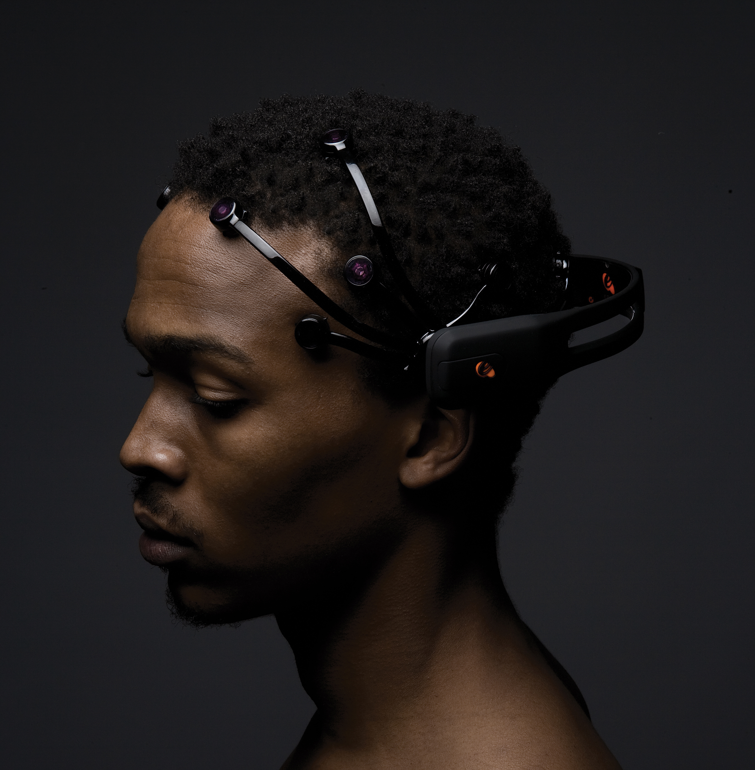
Emotiv EPOC+
Hardware:
14-channel wireless EEG
Designed for contextualized research and advanced brain computer interface applications
$800 and widely available
Notes:
SH
Yes there is! It is called the Emotiv Epoc and it is specifically designed for recreational uses, contextualized research and advanced BCI applications.
And it costs only $800.

Slide 6

Connectome
A hardware/software solution specifically designed to allow a person with ALS to communicate with friends and family using social media - specifically Twitter
Notes:
What better way to allow patients to communicate with their loved ones than through existing social media platforms?
Our goal is to create an application that allows for training of the emotiv and navigation of various social media apps through the use of mental commands.

Slide 7
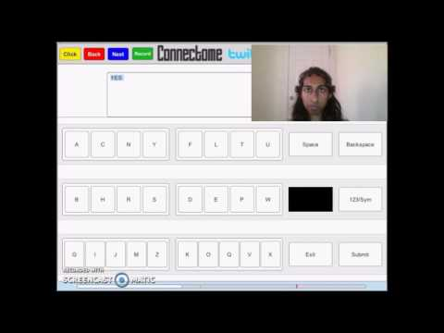
Connectome Demo
Notes:
Bairavi will be attempting to reply to a tweet through Connectome using her brain.
To do that, she has to navigate to timeline, selecting a tweet.
Next she will choose reply option.
Next she'll type using a connectome keyboard, accomplishing the task.
[Khaled]
Now, the concept of interpreting the brain is sophisticated, but I'll try to simplify it for time's sake.
Let's say that I am the brain. And Kennan is the Emotiv device. We'll ask Kennan to memorize my stance and label is at Neutral. Next, we'll do that same thing but ask Kennan to label this stance as Active. Now Kennan should be able to tell whether I'm neutral or active. And he will report what he sees to Connectome filling the bottom bar as more Active states are registered.
[Kennan]
The bar at the bottom has two thresholds, a refresh threshold coloured yellow, and click threshold colored red. When the bar is filled above the refresh threshold, it'll hold the highlighter. Upon reaching the click threshold, Connectome will register a click.
Fillers:
The top bar [ Four buttons, Device status ].
Models of keyboards.
Compatible with any device.

Slide 8

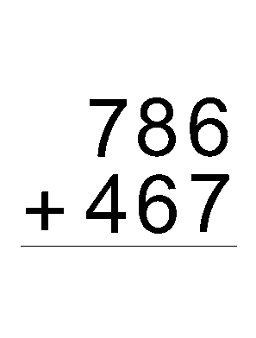

Training Paradigms
BLINKING
SSVEP
UNIQUE
Notes:
Because brain activity is triggered in multiple ways, there are several paradigms users can train with such as Blinking, SSVEP, and Unique.
While blinking is not truly a mental command, it is still a reproducible method that users with remnant eye function can perform.
The Emotiv device can detect blinks due to its EMG sensors that pick up muscle movements.
SSVEP, the method used for the demo earlier, is a paradigm that is reliably detected by the Emotiv. It is a truly mental command, not reliant on any muscle movements.
Finally, users can also train with their own unique paradigm such as performing math equations or imagining playing a musical instrument.
KH

Slide 9

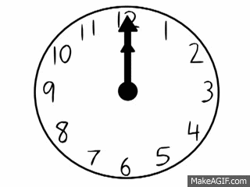

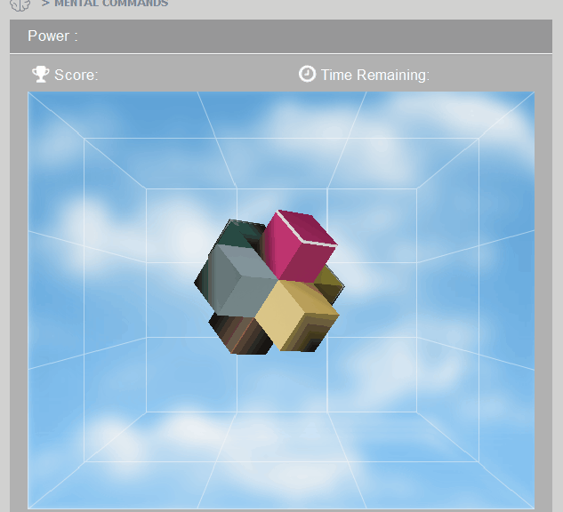
Adaptive Learning
DURATION
POWER
ACCURACY
Notes:
Once a user has identified a successful training paradigm, Connectome offers an Adaptive Learning platform in the form of several tests.
The tests assign Duration, Power, and Accuracy scores.
These scores are used to adjust Connectome's parameters such as ClickRate and RefreshRate
First, the Duration Test measures how long a user can sustain either a neutral or active state.
Second, the Power Test measures how much power a user can execute a command.
Finally, the Accuracy Test measures how accurately a user can generate the target command.
The idea behind this platform is two-fold.
Not only do users have the chance to improve their skills, but the software automatically begins adjusting thresholds based on a user’s performance.
Based on training data, thresholds for power and duration will automatically be adjusted to reflect the experience level of each user.
KH

Slide 10
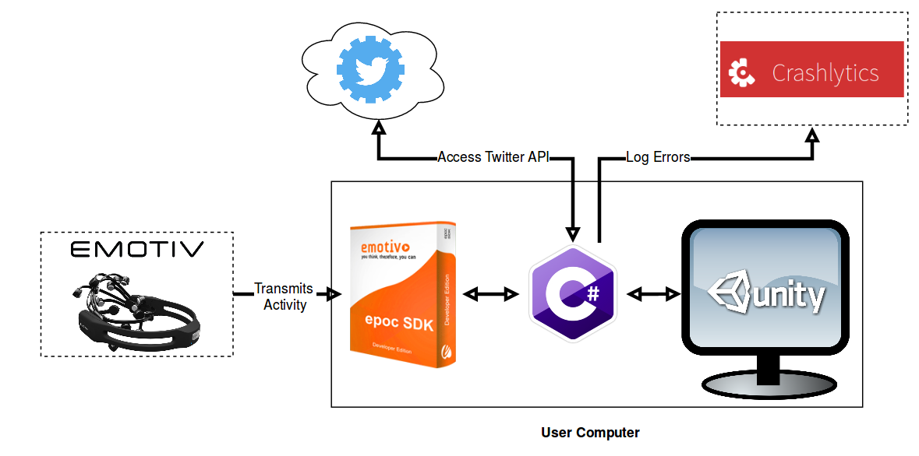
Technologies
Notes:
Nate
Visual Studio - C#
Unity
Advantages
Ease of implementation - GUIs
C# - Emotiv SDK
Cross Platform
Large community
Disadvantages
Git merging of scenes
.NET version
Not lightweight - requires quite a lot of resources

Slide 11

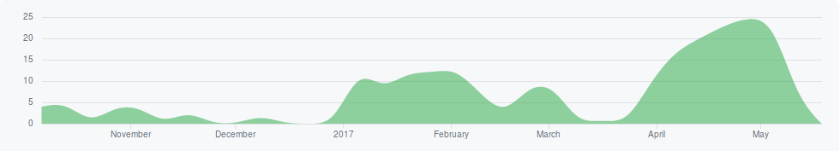
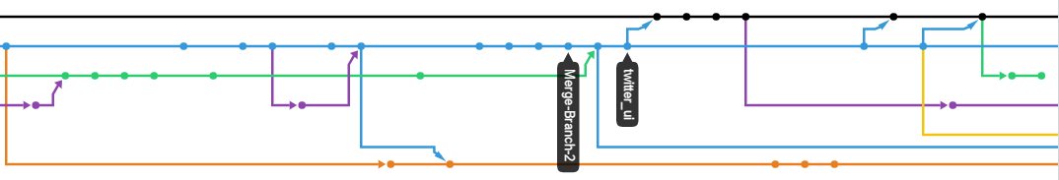
Development Tools
Notes:
Nate
Project Lifecycle - Rapid Prototyping
October - November - Attempt at web application
November - Desktop App with HTML
December - Emotiv training and calibration
January-Feb - Main coding of app with unity
March - Focus on documentation
Branching
Code changes never committed directly to master
Merge branches together into separate branch to avoid conflicts in master, pulled into master once fixed

Slide 12
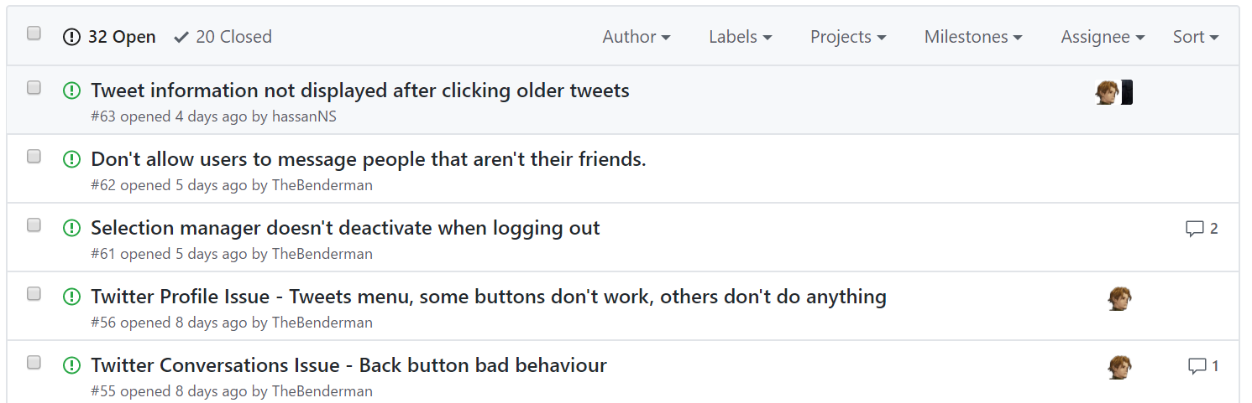
Development Tools
Notes:
Nate
Issues tracked in Github
Feature Requests
Bugs
Priority
Assigned to developer
By specifying the issue number in the commit message, when an issue is fixed, it is automatically logged to the web application.

Slide 13
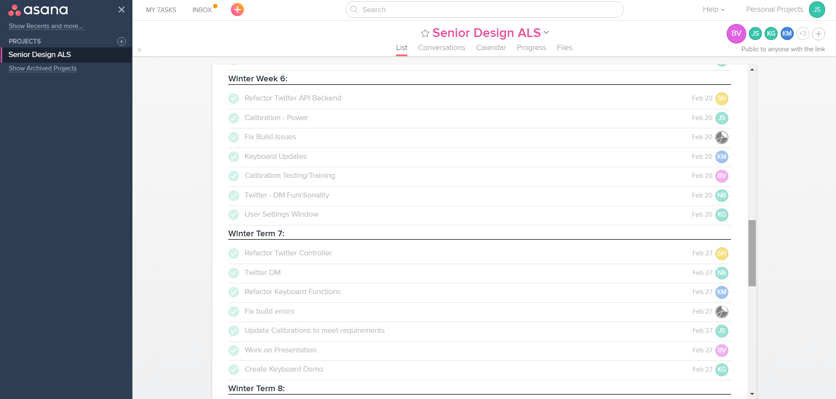
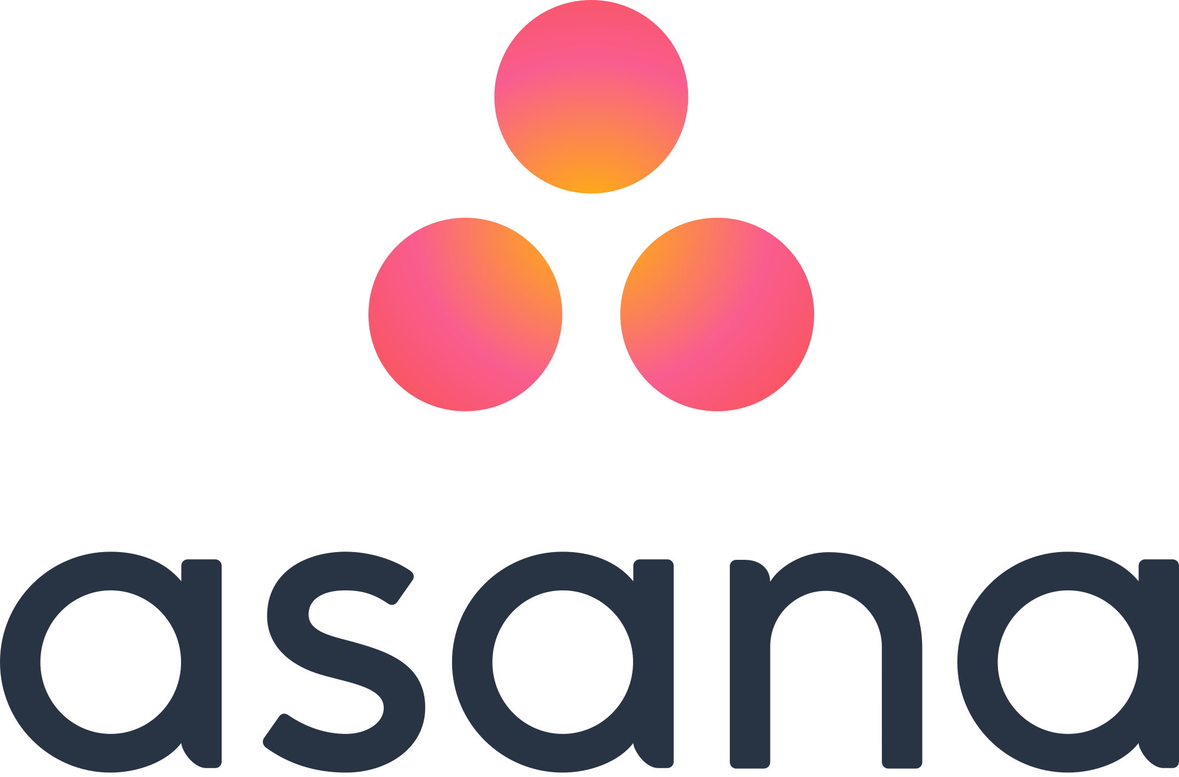
Development Tools
Notes:
Nate
Asana
Stand-up after monday status meeting - assign tasks (granular assigned to single person)

Slide 14


Standards
Software:
UML 2.0 Standard
Microsoft C# Coding Conventions
Nielsen's Ten Heuristic Principles
Shneiderman’s Eight Golden Rules
Clinical:
21 Code of Federal Regulations
Protection of Human Subjects
Notes:
During the course of our planning and development, we used several standards and best practices.
For planning and architecture we followed the UML 2.0 standard,
For our C# development, we used Microsoft’s C# Coding Conventions
And for our planning and development of our UI, we used both Nielsen's Ten Heuristic Principles and Shneiderman’s Eight Golden Rules
Since we will be testing using human subjects, we will follow the 21 Code of Federal Regulations which describes the standards for the protection of Human Subjects
1 Strive for consistency.
Consistent sequences of actions should be required in similar situations; identical terminology should be used in prompts, menus, and help screens; and consistent commands should be employed throughout.
2 Enable frequent users to use shortcuts.
As the frequency of use increases, so do the user's desires to reduce the number of interactions and to increase the pace of interaction. Abbreviations, function keys, hidden commands, and macro facilities are very helpful to an expert user.
3 Offer informative feedback.
For every operator action, there should be some system feedback. For frequent and minor actions, the response can be modest, while for infrequent and major actions, the response should be more substantial.
4 Design dialog to yield closure.
Sequences of actions should be organized into groups with a beginning, middle, and end. The informative feedback at the completion of a group of actions gives the operators the satisfaction of accomplishment, a sense of relief, the signal to drop contingency plans and options from their minds, and an indication that the way is clear to prepare for the next group of actions.
5 Offer simple error handling.
As much as possible, design the system so the user cannot make a serious error. If an error is made, the system should be able to detect the error and offer simple, comprehensible mechanisms for handling the error.
6 Permit easy reversal of actions.
This feature relieves anxiety, since the user knows that errors can be undone; it thus encourages exploration of unfamiliar options. The units of reversibility may be a single action, a data entry, or a complete group of actions.
7 Support internal locus of control.
Experienced operators strongly desire the sense that they are in charge of the system and that the system responds to their actions. Design the system to make users the initiators of actions rather than the responders.
8 Reduce short-term memory load.
The limitation of human information processing in short-term memory requires that displays be kept simple, multiple page displays be consolidated, window-motion frequency be reduced, and sufficient training time be allotted for codes, mnemonics, and sequences of actions.
Visibility of system status
Match between system and the real world
User control and freedom
Consistency and standards
Error prevention
Recognition rather than recall
Flexibility and efficiency of use
Aesthetic and minimalist design
Help users recognize, diagnose, and recover from errors
Help and documentation

Slide 15
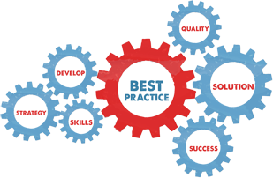
Best Practices
Variable Naming Conventions
Decentralized Version Control
Exception Handling
Paired Programming
Develop Iteratively
Component Architectures
Design Patterns
Notes:
As mentioned, we implemented several best practices in our development cycle:
Some important best practices listed include:
Iterative Development
Component Architectures
Design patterns
Unit testing

Slide 16
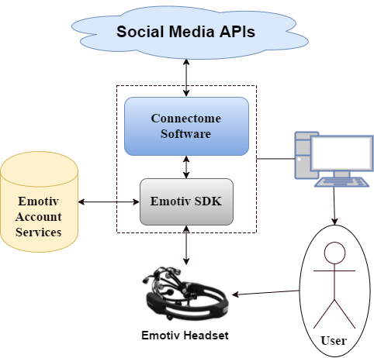
System Architecture
Notes:
Shown is a high-level architectural diagram of our application.
At the core of our application is the EMOTIV SDK which handles the processing of brain activity provided by the emotiv headset, using user information stored in EMOTIV’s account services. Our software, a combination of C# and UNITY, interfaces with the EMOTIV software to receive the processed mental activity.
Based on user input, our software will leverage various social media API’s to perform social media functions such as posting and browsing.
It is important to note that the user only receives input from their computer, the primary input device of our architecture is the EMOTIV headset.

Slide 17
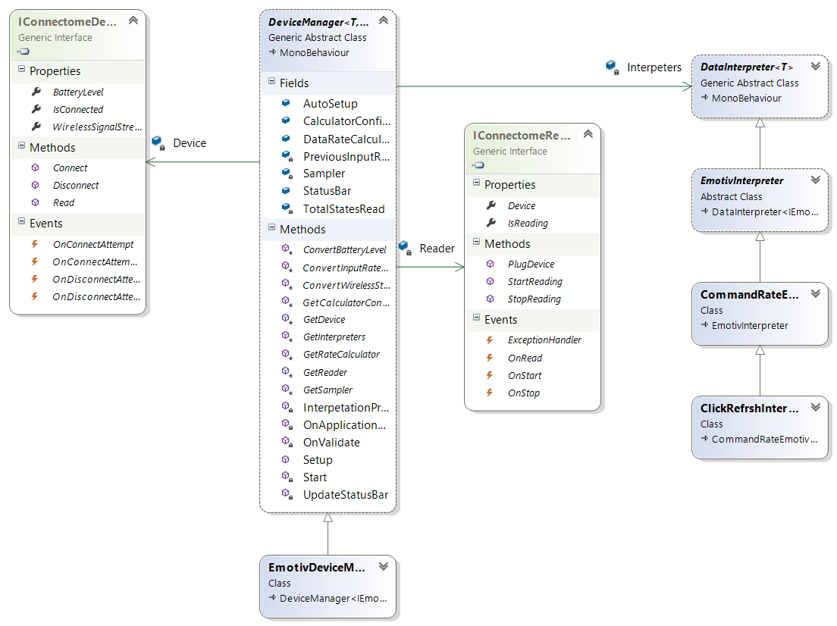
Design Patterns
Template
Builder
Mediator
Notes:
With the mediator pattern, communication between objects is encapsulated within a mediator object. Objects no longer communicate directly with each other, but instead communicate through the mediator.
Builder Pattern: Separate the construction of a complex object from its representation so that the same construction process can create different representations.

Slide 18
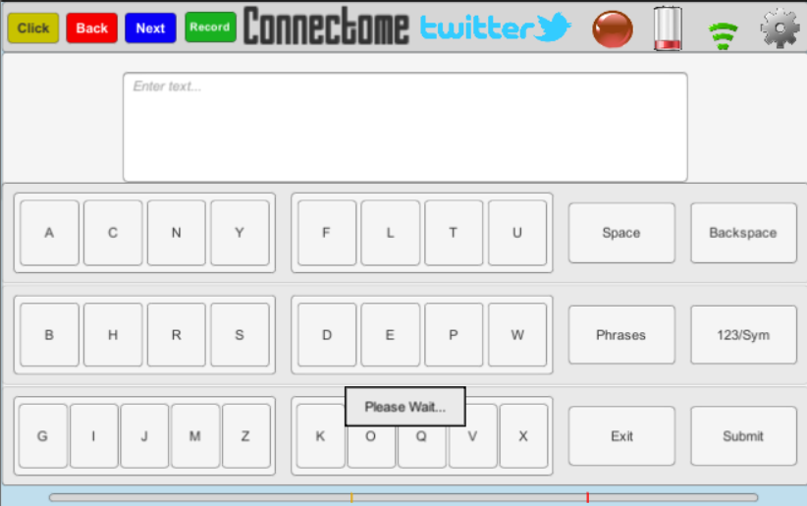
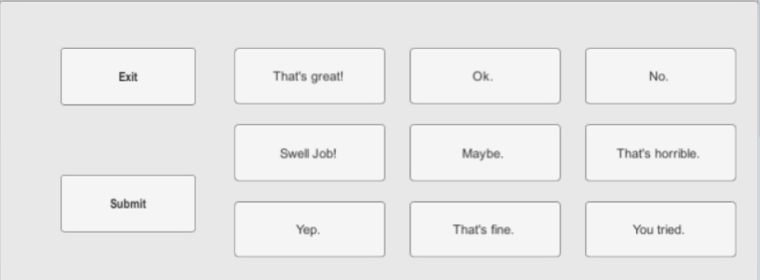
Keyboard
Configurable :
JSON
Interchangeable :
Grid
QWERTY
Phrases
Notes:
One major component of our project is the user input since we are dealing with communication through social media.
Because of this, when designing our keyboard we focused on making it configurable and interchangeable.
Pictured is our “Grid Keyboard”, which allows the user to either type a free response,
[click]
Or, select from pre-generated phrases. The keys and phrases are all generated from JSON, allowing for dynamic configurations based on the user’s preference.
We have other keyboards available as well, such as a traditional QWERTY keyboard and a keyboard containing only phrases.
The user is able to switch between these different keyboards at runtime.
To figure out which keyboard layouts were the most efficient, we also developed a side tool that calculates the amount of time it takes to navigate through a given layout and type out a list of commonly-used words. The results we gathered from this tool has helped to develop our Grid Keyboard.

Slide 19
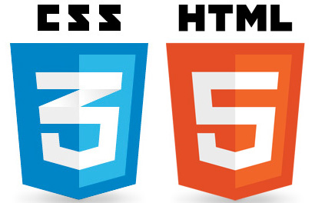

Alternative Designs
Web Application
Pros: Social Media APIs, ease of impl.
Cons: Send Emotiv data over connection
Desktop Application with JS/HTML
Pros: Social Media APIs
Cons: Emotiv SDK, Arch. technologies
Java Desktop Application with Swing
Pros: Emotiv SDK, ease of implementation
Cons: UI Development, Social Media APIs
Notes:
The different keyboard layouts we have are just one example of many different design considerations we have encountered throughout the course of the project.
Connectome itself started out as a Web Application to make it easy to interact with various social media APIs. The problem with this was that we did not want to send the Emotiv packets through an internet connection to be interpreted, as we wanted to reduce as much of the potential latency from our application as possible.
So, we moved to a Desktop Application using Javascript and HTML. The problem with this approach, however, was that we could not find an appropriate architecture that would be compatible with the Emotiv SDK.
Finally, we moved to a Java Desktop Application, implemented using Java Swing. While the Emotiv worked well here, the Social Media APIs were less trivial to implement.

Slide 20
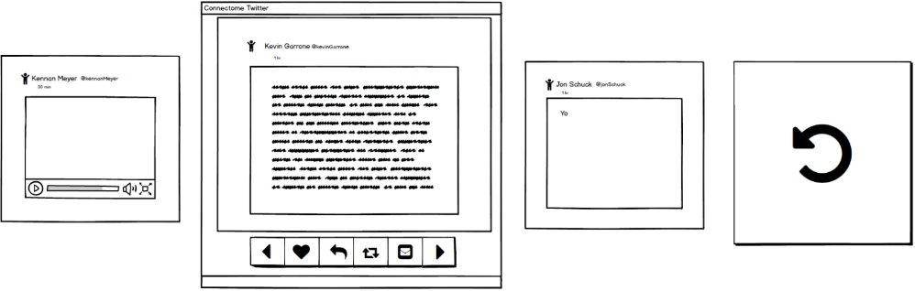
Alternative Designs
Notes:
Our User Interface has also gone through various changes over the course of the project. Pictured is our initial mockup of the Twitter timeline, created through Balsamiq. We modified the design when moving into our implementation, such as moving the back button pictured at the right, from the main panel into the bottom navigation bar.

Slide 21
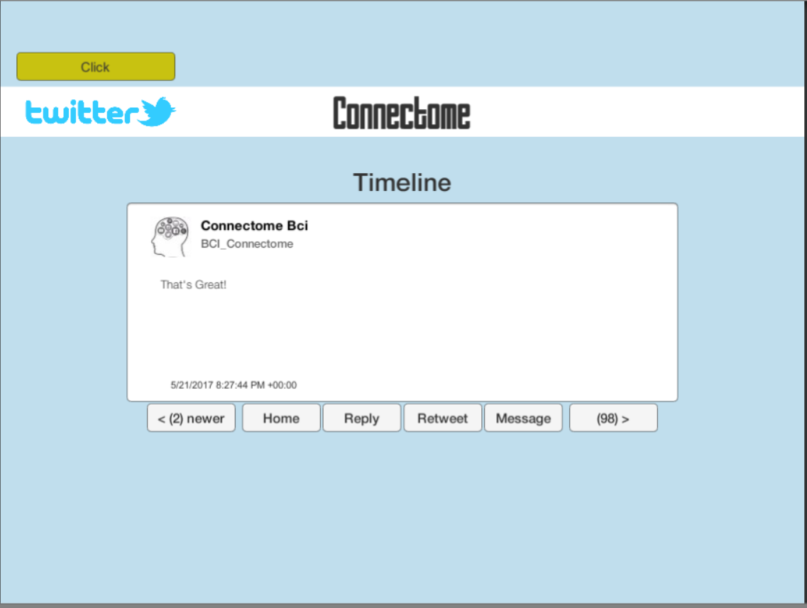
Alternative Designs
Notes:
Pictured next is our initial implementation of the timeline in Unity. We received good feedback from our contributor Libu, who suggested that we add more tweets to the screen to further reduce the amount of time the user spends navigating the timeline.

Slide 22
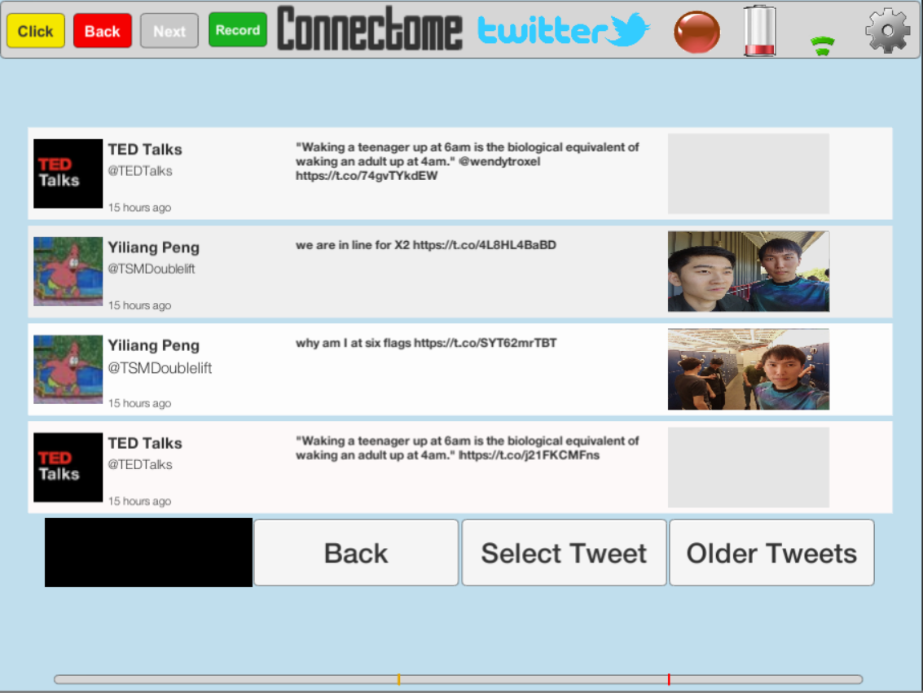
Alternative Designs
Notes:
As a result, we shifted to a layout with a list of four tweets at a time, better mimicking the Twitter environment.
However, we decided that with this approach, each individual tweet was more difficult for the user to read...

Slide 23
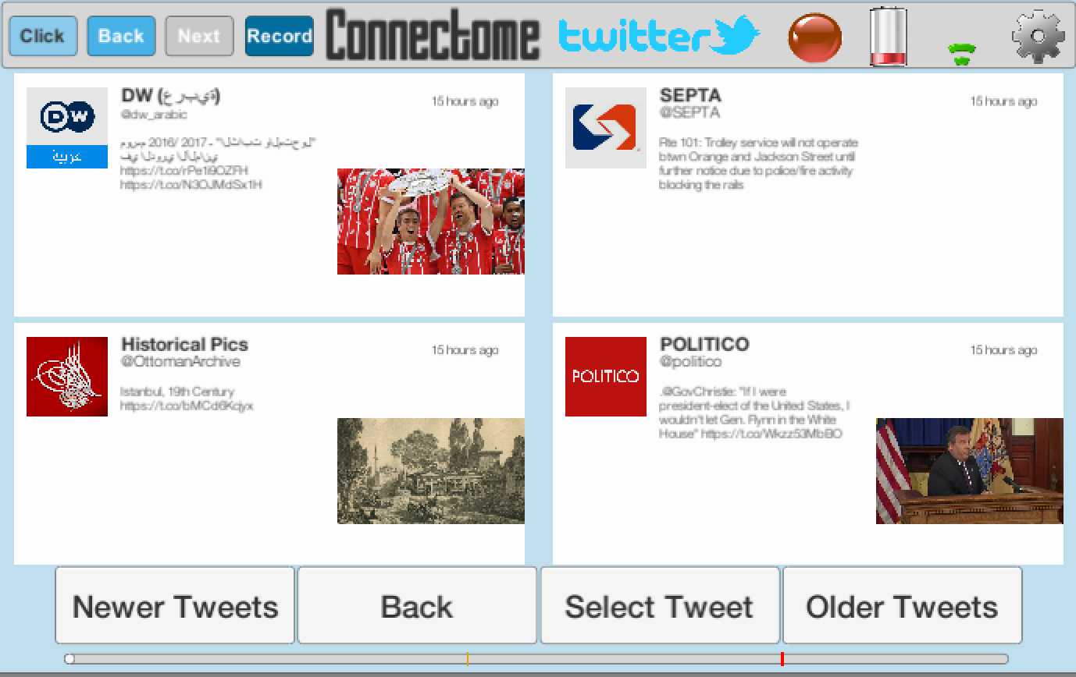
Alternative Designs
Notes:
...So we adjusted our layout to give each tweet more real estate, as pictured in our final iteration of the timeline.

Slide 24
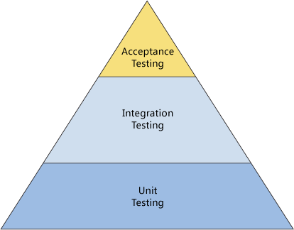
Testing
Software:
Unit
Integration
Performance
Acceptance
User:
Internal
Patient
Notes:
JS
For our application, we were forunate enough to not only to perform Unit, Integration, Performance, and Acceptance testing as well as tesing within our own team, but we were also given the oppurtunity to test with ALS pateints in their own homes

Slide 25
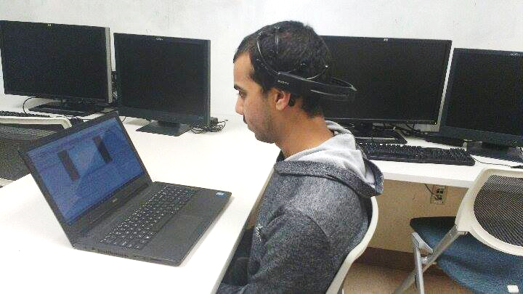
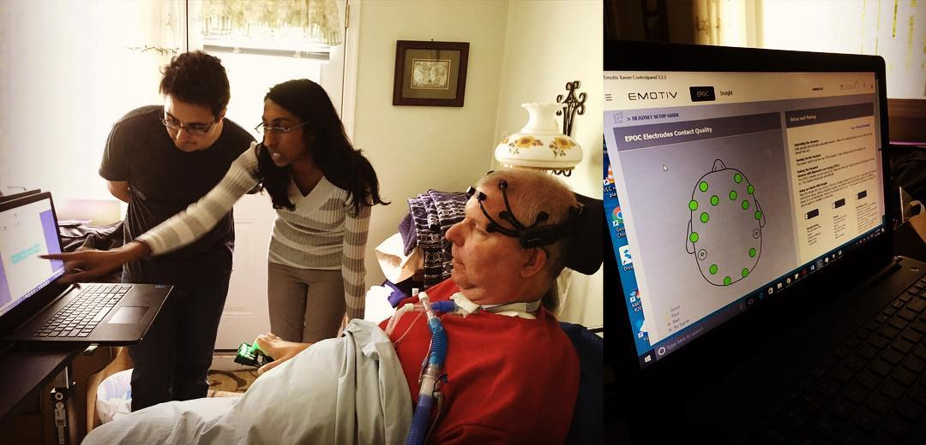
Testing - Procedure
Subjects
6 Connectome Team Members
2 ALS Patients
Objectives
Standardized Approach
Comfort Patient
Test Multiple Paradigms
Format
1) Equipment and Software Setup
2) Create Emotiv Profile
3) Complete Adaptive Training
4) Attempt Twitter
Notes:
JS
Our user testing included 6 members of our own team, and 2 ALS patients. For our testing, we created a standardized procedure. Which allowed us meaning data as well as helping to comfort our patients and test multiple paradigms. The basic of view of our proccedure overview is first to set up the equipment

Slide 26
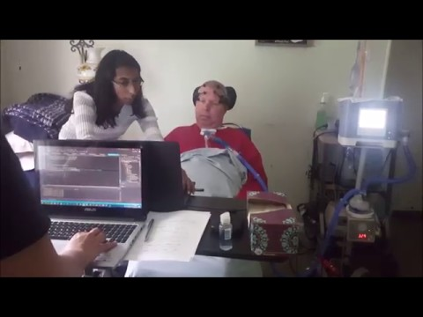
Testing
Notes:
JS
Thanks to Sarah feildman and the ALS hope foundation, we were able to test with ALS patients in their own home. This allowed us to see the enviroment our software would be used in, and notice problems that would not normally appear in a controlled enviroment. Also, using the adoptive training, we were able to collect data to helps us improve our application.

Slide 27
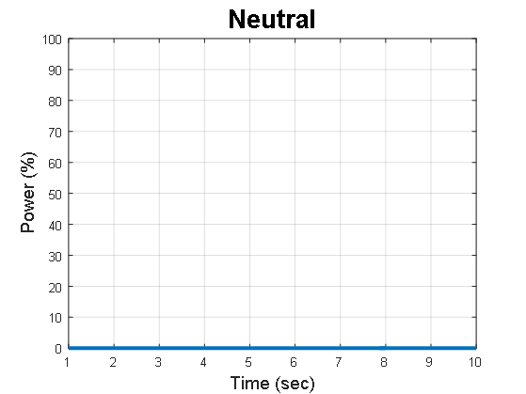
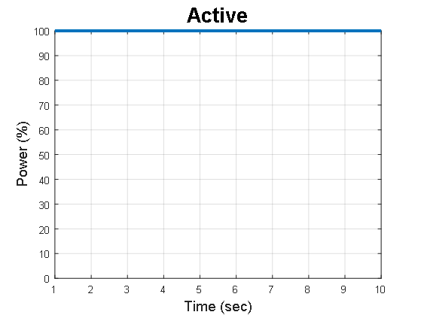
Results - Ideal
No false positives in either Neutral or Active states
Notes:
BV
Ideal test results for a subject in a perfect world would look something like the graphs pictured here.
The subject would be able to hold a Neutral and Active state for the entire 10 seconds of the training session without producing any false positives
After two weeks of conducting trainings on our own selves, we found that, we are, in fact, not perfect, but rather fall into one of three main categories

Slide 28
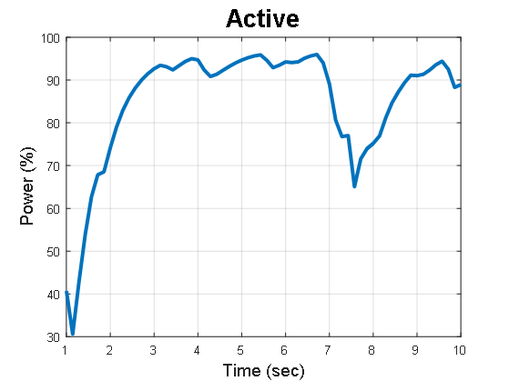

Results - Type A
No false positives in Neutral state
Active state is sustained for significant duration
Notes:
BV
We denoted the first such category as Type A
These users are able to hold an ideal neutral state and maintain an active state for the majority of the training session with some minor dips in power, but no false positives
We found that setting high click and refresh rates for such users is successful.

Slide 29
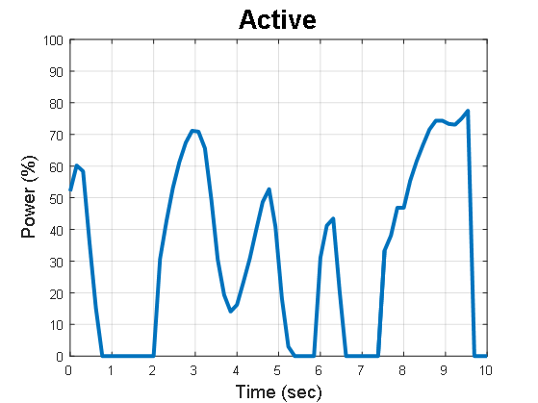

Results - Type B
No false positives in Neutral state
Active state is maintained, but with intermittent false positives
Notes:
BV
A Type B user can again, maintain an ideal neutral state, but generates a handful of false positives in their active command
The majority of users fall into this category.
Connectome can still cater to these users by setting lower click and refresh thresholds

Slide 30
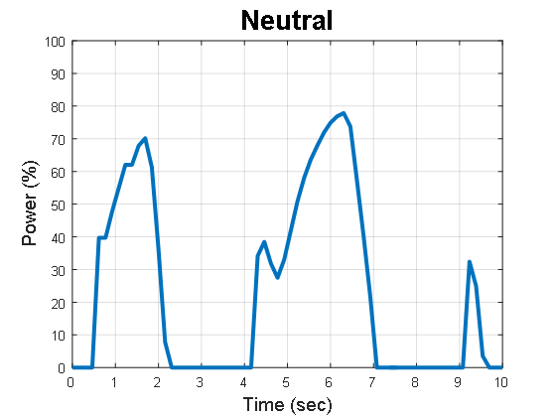
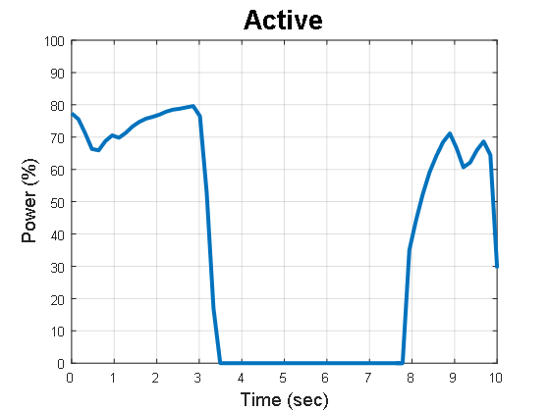
Results - Type C
Many false positives in both Neutral and Active states
Notes:
BV
Finally, a type C user experiences difficulty in holding both neutral and active states
For these users, the typical protocol is to continue retraining the original profile or change the training paradigm altogether.

Slide 31
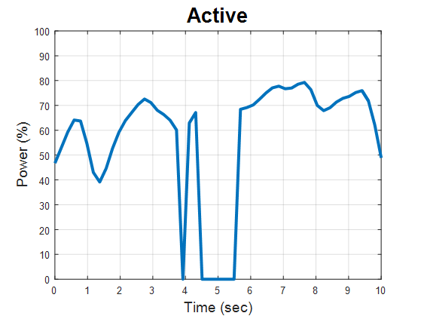
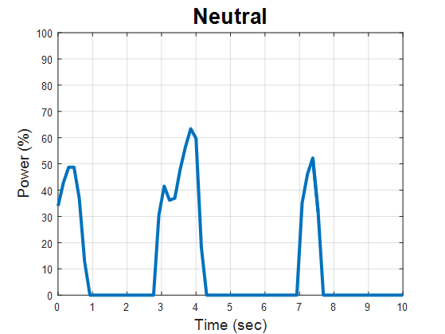
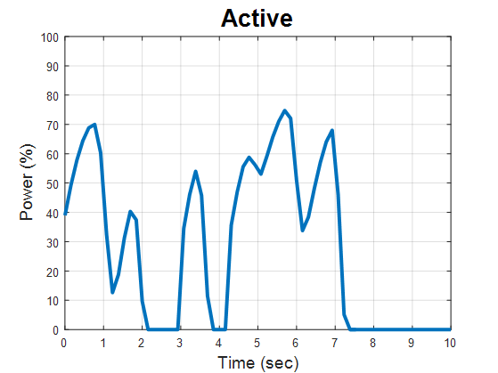
Results - ALS Patients
Subject 1
Subject 2
TYPE B
TYPE C
Further Training Necessary
Notes:
BV
We are proud to say we were able to validate results we got in 2 weeks in just 2 hours when we trained with ALS patients.
The first subject fit a Type B profile and we are confident that with a few more training sessions, he would have been able to navigate Connectome successfully.
Due to technical difficulties, we were only able to spend a good portion of an hour training with Subject 2 and were therefore unable to properly configure the system to her level of performance. Again, we expect better results with a few more training sessions.

Slide 32
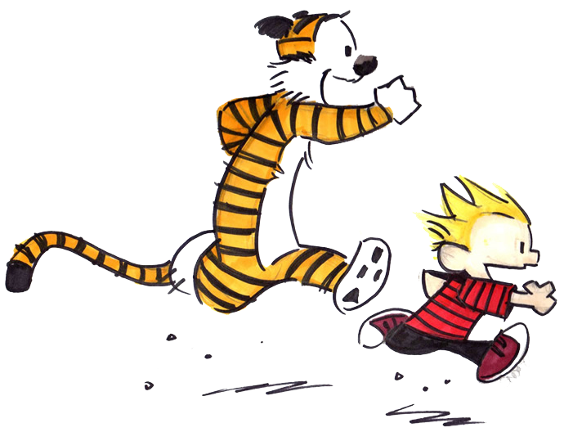
Questions?
Notes:
BV
As we look to the future we are hopeful that expanding and refining our proof of concept project will help better the lives of several more ALS patients.
Thank you for your attention, we will be happy to take any questions you may have now.

Slide 33
BACKUP

Slide 34
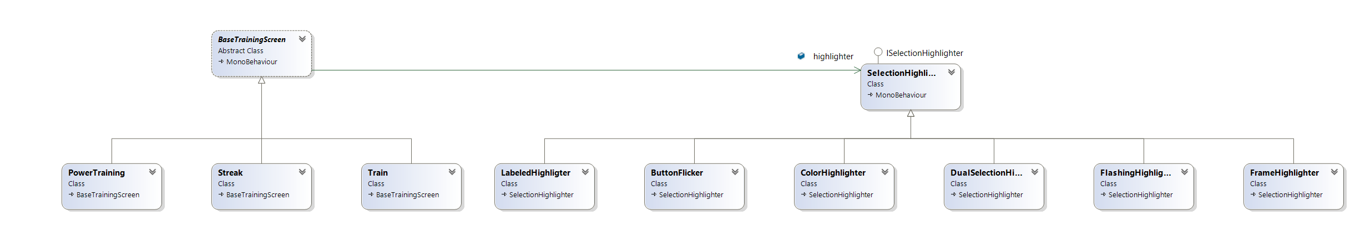
Design Patterns
Bridge
Notes:
We used the bridge pattern to separate the abstraction of our Button Highlighter implementation from our training screens .

Slide 35

Use Cases
User 1:
Training Results:
High Accuracy Score
Low Power Score
User 2:
Training Results:
Low Accuracy Score
High Power Score
Notes:
Let's take a look at two user examples,
User 1 has High Accuracy score, but low Power score, so we adjust thresholds to be lowered for that user to haste their response.
User 2, on the other hand, has low accuracy score and high power score, so we adjust thresholds higher to avoid mis interpreting false positives.
KH

Slide 36
Future Directions
Conduct more testing across a wider subject pool
Collect raw EEG data
Test different data interpreters to robustly create slider thresholds
Dynamic User Settings
Improved Keyboard
Adaptive Training Improvements
Additional Social Media Implementations
Notes:
BV

Slide 37
Twitter Demo

Slide 38
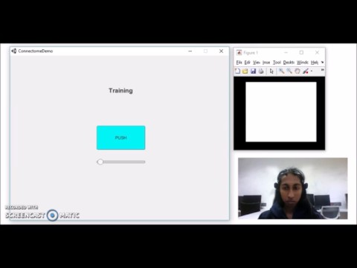
Adaptive Training - Accuracy

Slide 39
Adaptive Training - Power

Slide 40
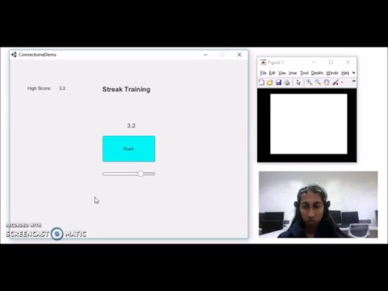
Adaptive Training - Streak

Slide 41
ALS Patient Testing
Sample Size = ~ 1
Testing Location = Patient’s home or Temple University Clinic
Duration = 2 to 4 hours
Paradigms = 1 to 2
Procedure
- Equipment and Software Setup
- User Profile Creation
- Adaptive Training Within Connectome
- Twitter

Slide 42
Metrics
Upon command, how many Tweets can a trained user send out in a span of X minutes?
Is there any improvement in Adaptive Training scores pre and post testing?
Usability and HCI Concepts for Connectome Application

Slide 43
Hardware Challenges
Reliability -Consistency of commands -Signal strength and clarity -Sampling rate -Noise from EMG electrodes
Compatibility -No cross-device implementation

